Slide 1
Azure-Service-Fabric
Notes:
https://courses.cs.washington.edu/courses/cse403/13au/lectures/git.ppt.pdf
http://enos.itcollege.ee/~jpoial/allalaadimised/git/getting-started-with-git.pdf

Slide 2
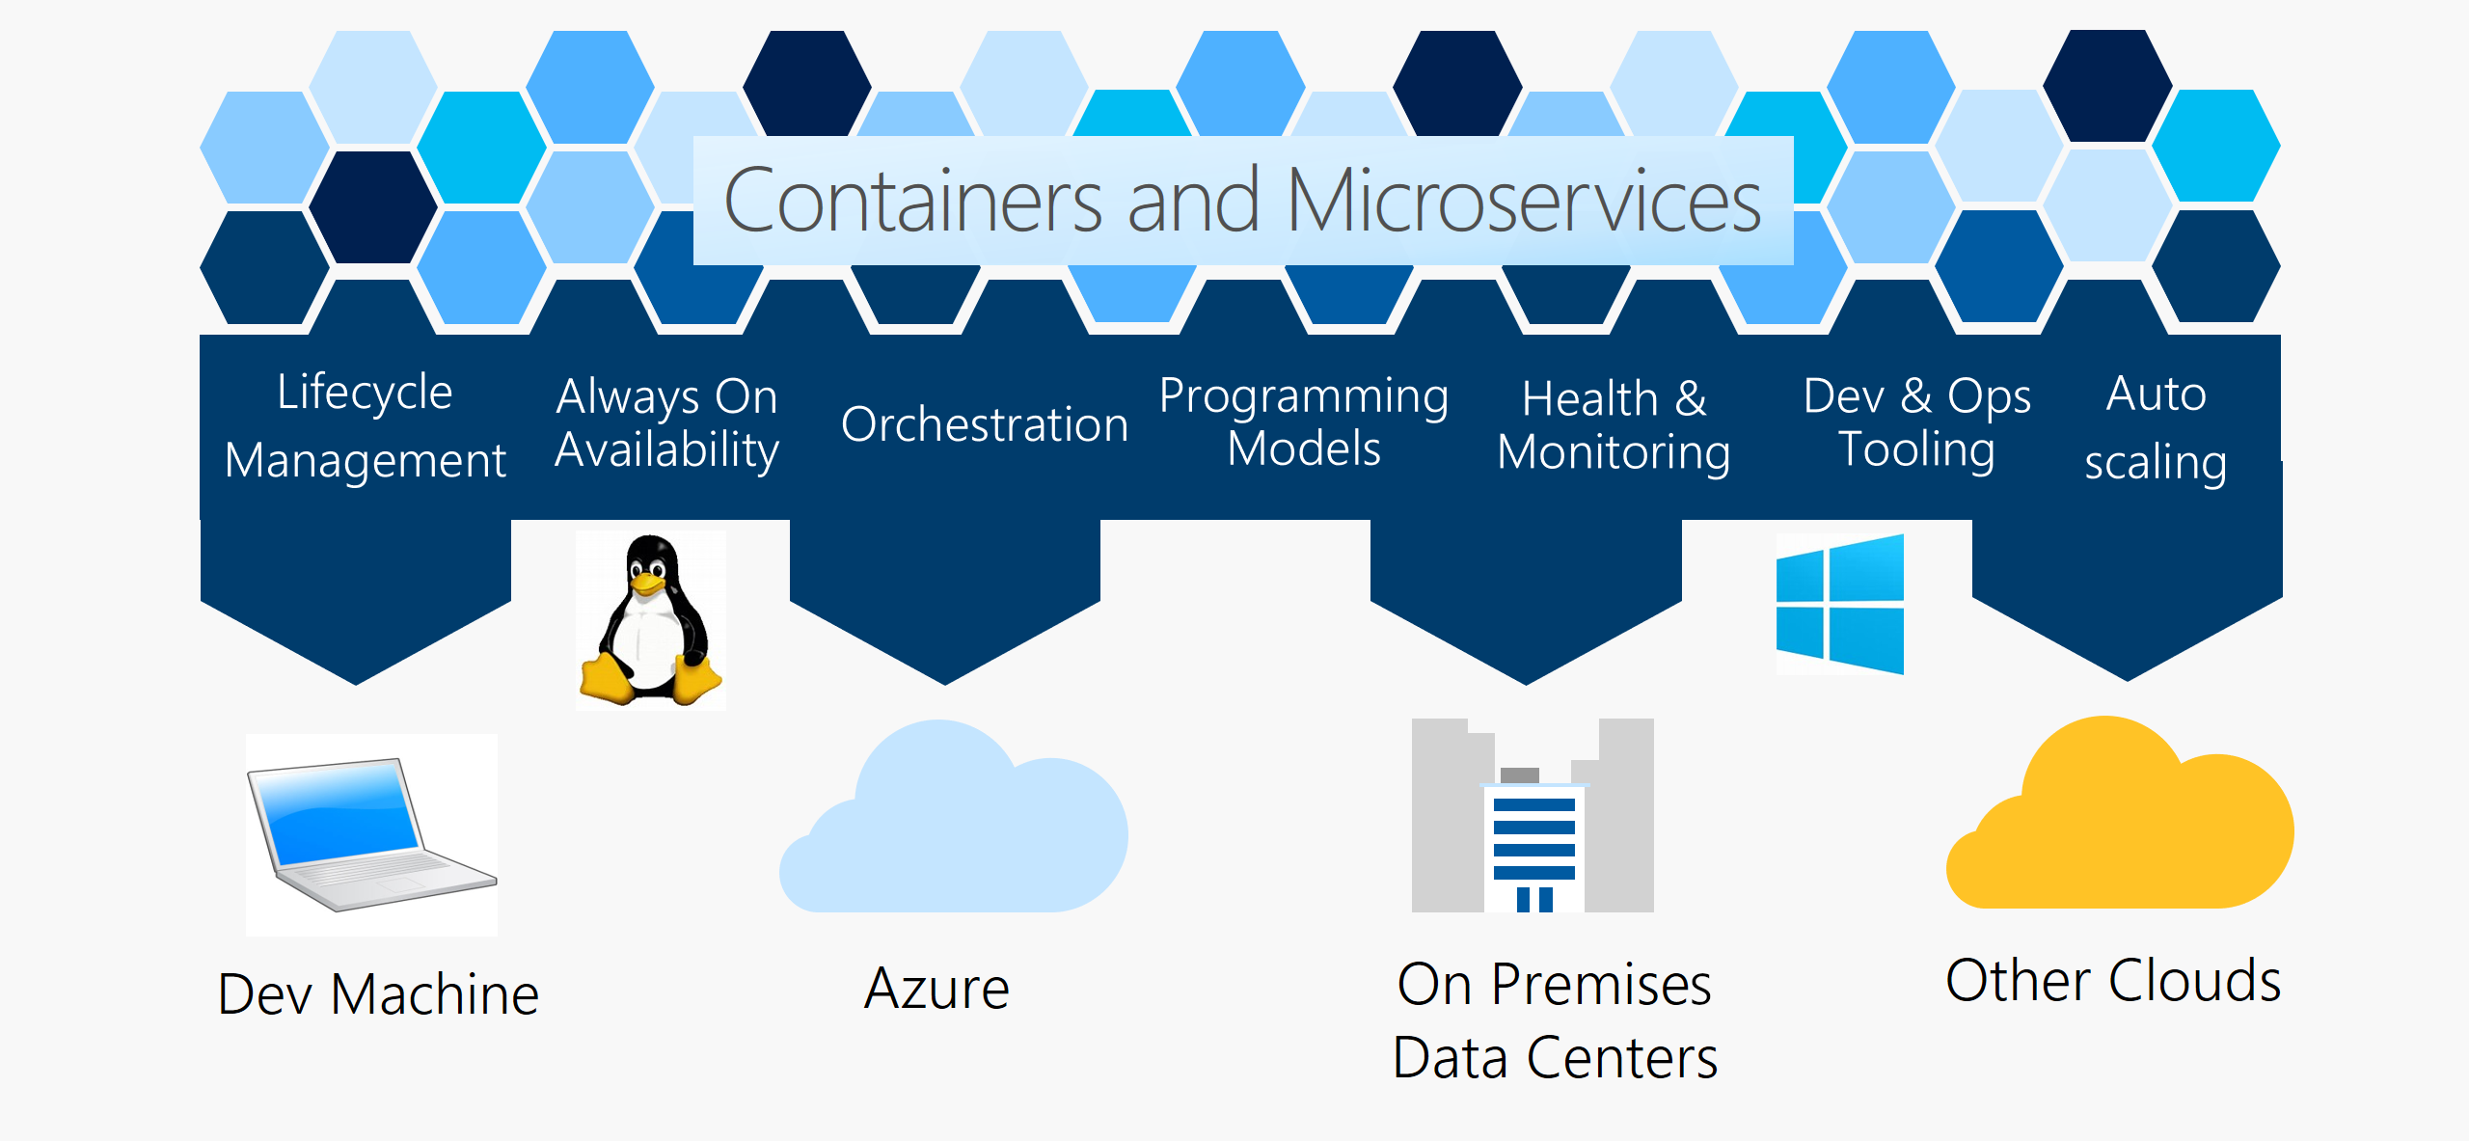
Overview
A distributed systems
Makes it easy to package, deploy, and manage microservices and containers

Slide 3
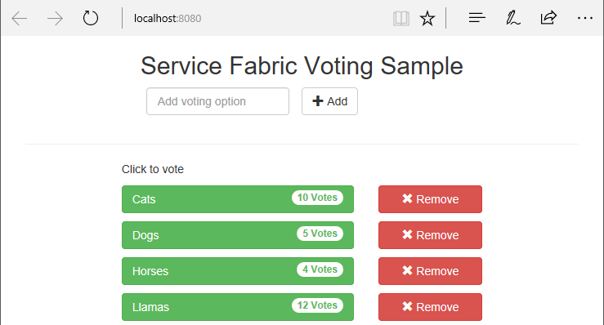
Deploy a .NET application

Slide 4


